Slide 1
Color Analysis Presentation
By: Student 2

Slide 2
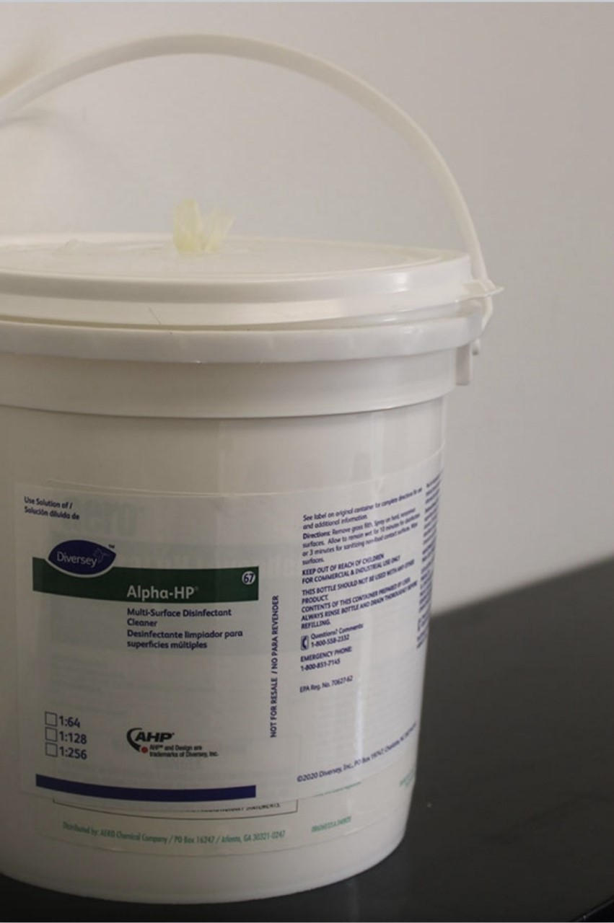
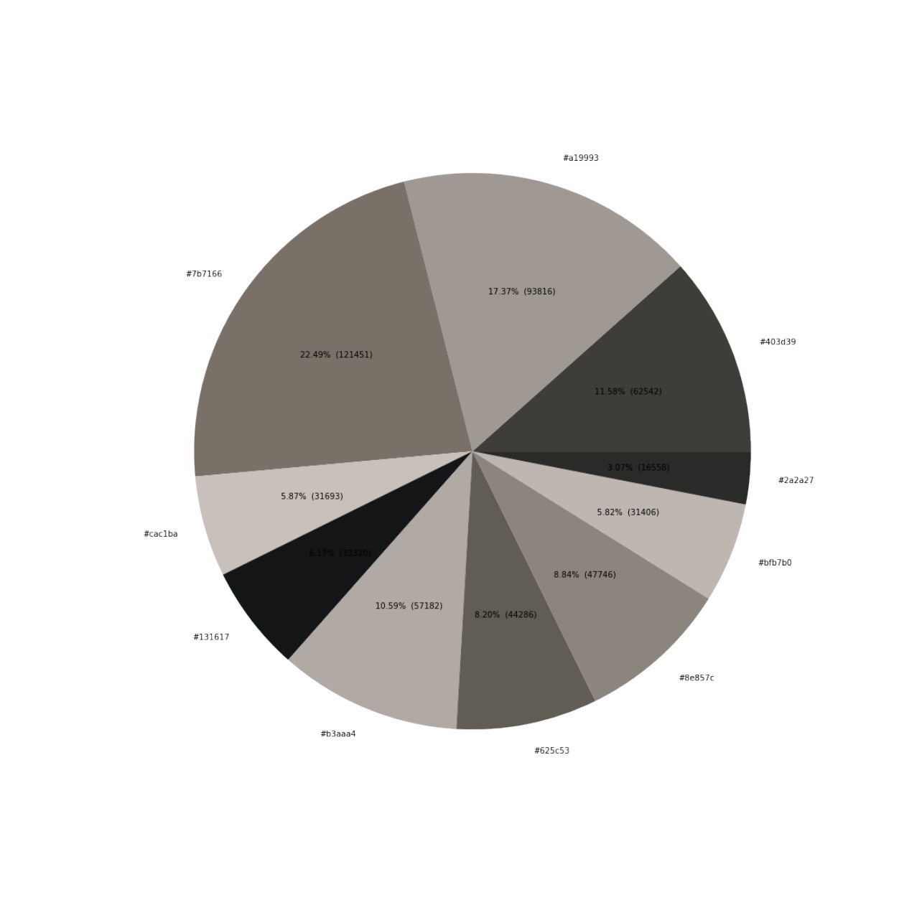
Monochromatic
1. Explain color harmony with color combination: Monochromatic coloring scheme with grey tones.
2. Write 5 hex colors with percentages: #7b7166 22.49%, #cac1ba 5.87%, #131617 6.17%, #b3aaa4 10.59%, #625c53 8.20%, #8e857c 8.84%, #bfb7b0 5.82%, #2a2a27 3.07%, #403d39 11.58%, #a19993 17.37%.
3. Which color is the most used? #7b7166 22.49%
4. What is the brightest color? #cac1ba 5.87%
5. What is the darkest color?
#131617 6.17%

Slide 3
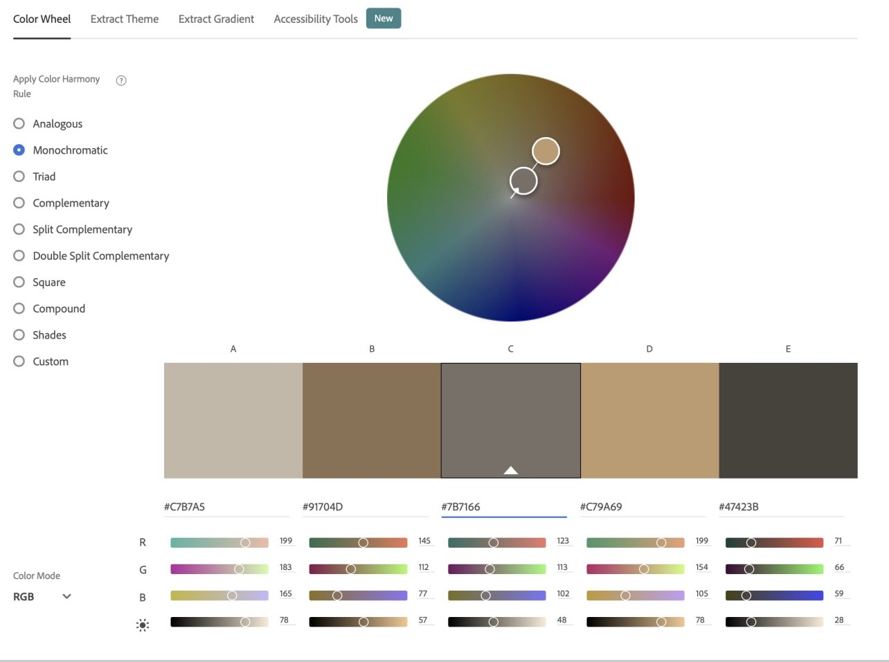
Improvement plan based on color analysis
6. Please write any suggestions to have better color harmony (2-3 sentences). When you see your photo, do you think that you have a full range of value? Do you have enough light tones (white)? Do you have enough dark tones (black)? If you can take a photo again, what can you improve it? This picture was decent to use but I probably could have done something better to make the different monochromatic shades and tones.

Slide 4
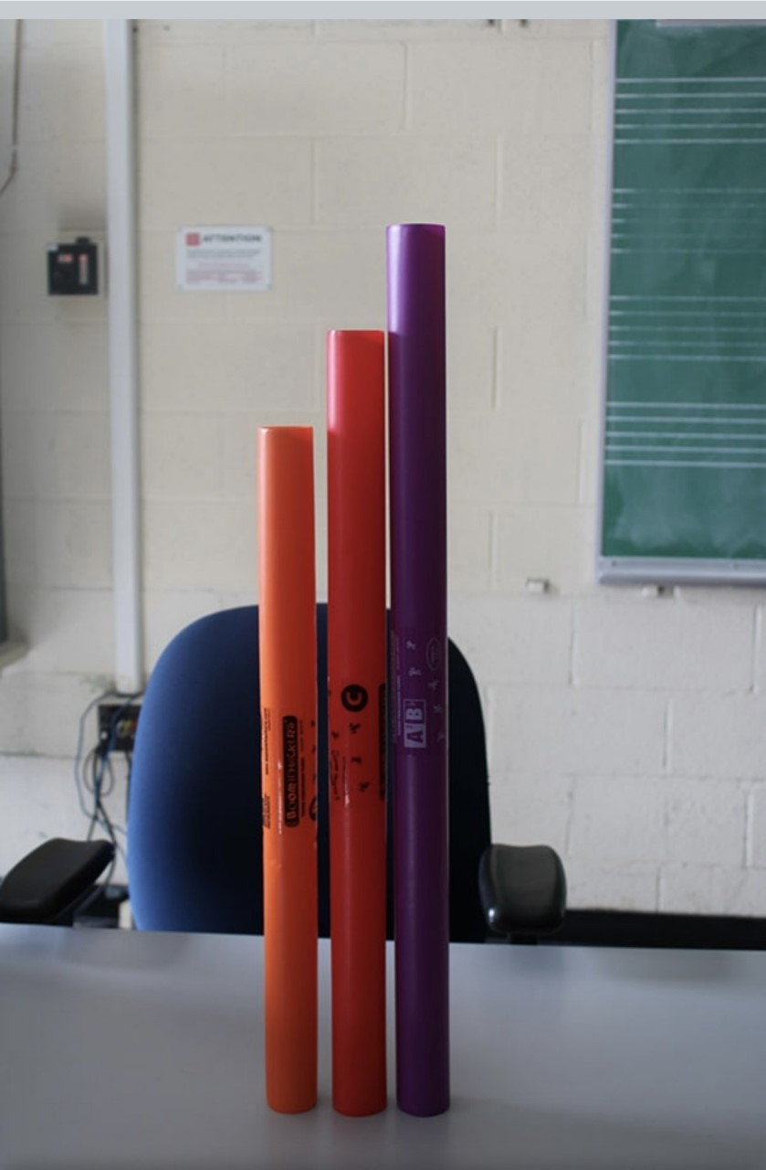
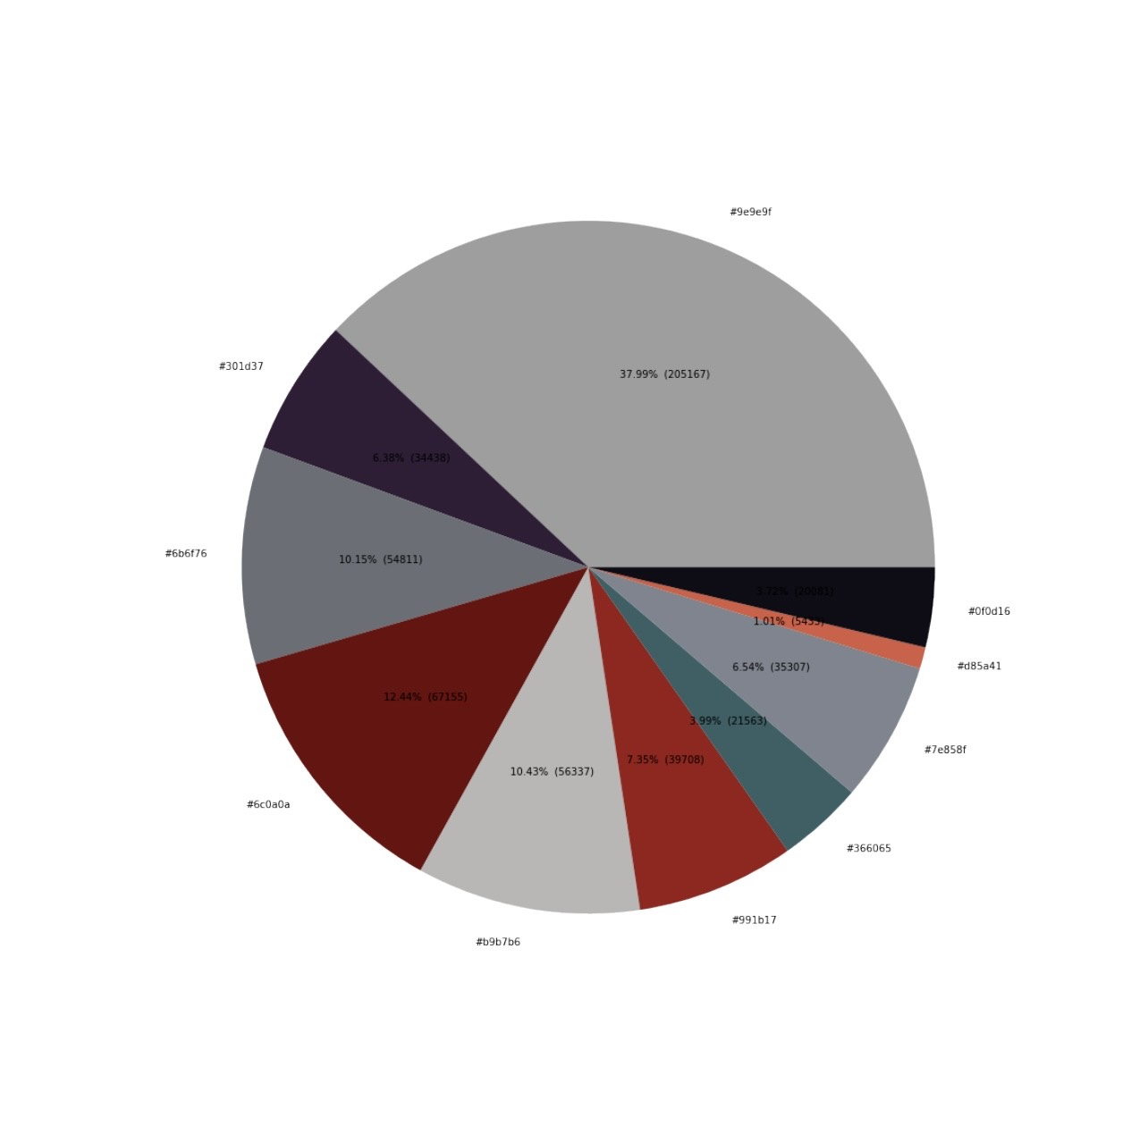
Analogous
1. Explain color harmony with color combination: Analogous color scheme with orange, red, and purple.
2. Write 5 hex colors with percentages: #301d37 6.38%, #6b6f76 10.15%, #6c0a0a 12.44%, #b9b7b6 10.43%, #991b17 7.35%, #366065 3.99%, #7e858f 6.54, #d85a41 1.01%, #0f0d16 3.72%, #9e9e9f 37.99%.
3. What is the color of the main subject? (color and percentage) #9e9e9f 37.99%
4. What are analogous colors (color and percentage)? #991b17 7.35%, #d85a41 1.01%, #301d37 6.38%.
5. What is the colors which are not analogous (color and percentage)? #9e9e9f 37.99%, #0f0d16 3.72%, #366065 3.99%, %, #6b6f76 10.15%, #6c0a0a 12.44%, #b9b7b6 10.43%.

Slide 5
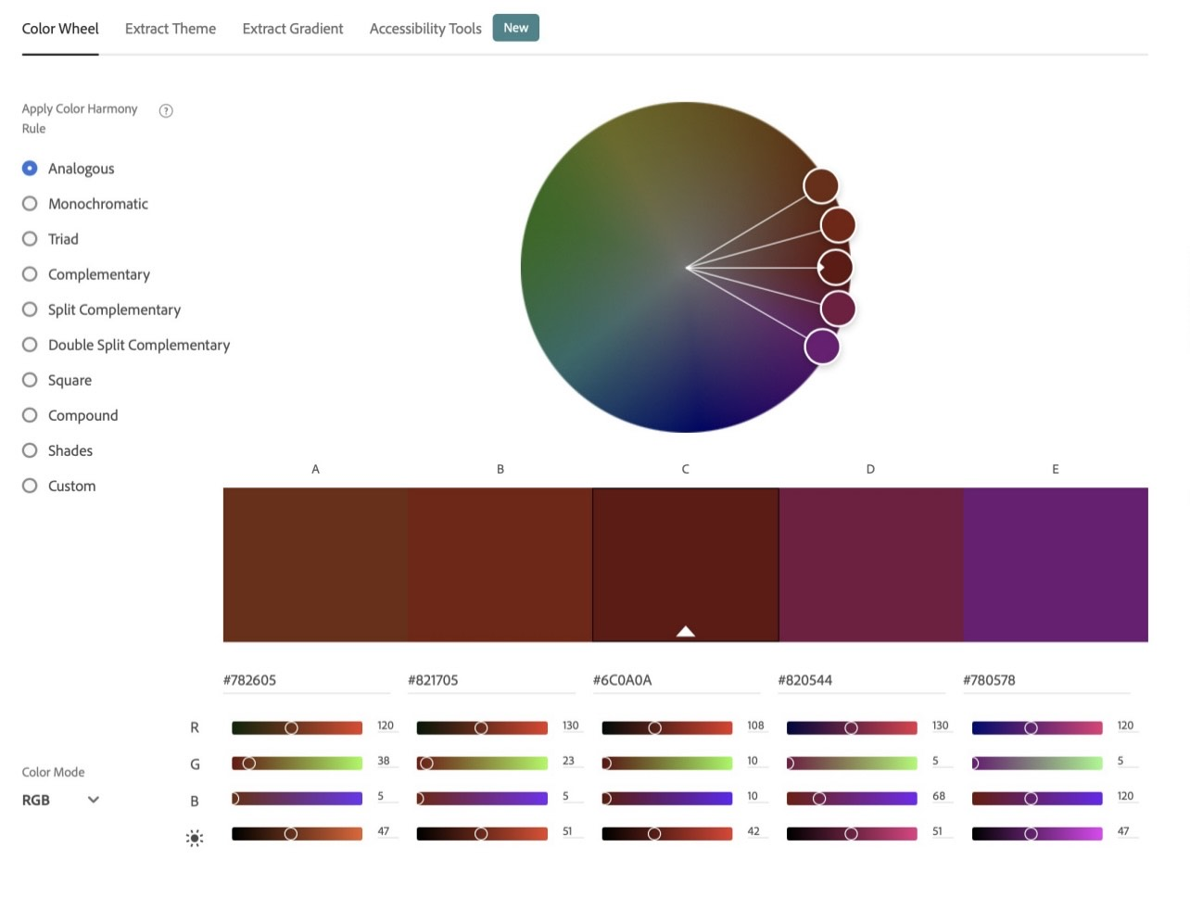
Improvement plan based on color analysis
6. Please write any suggestions to have better color harmony (2-3 sentences). When you compare your pie chart and the color wheels, which analogous colors are missing? If you can take a photo again, which color will be good to add for analogous harmony? Which color will be good to remove (background or distracting colors) for analogous harmony? I could have taken the picture differently so the background colors wouldn’t have been caught in my pie chart.

Slide 6
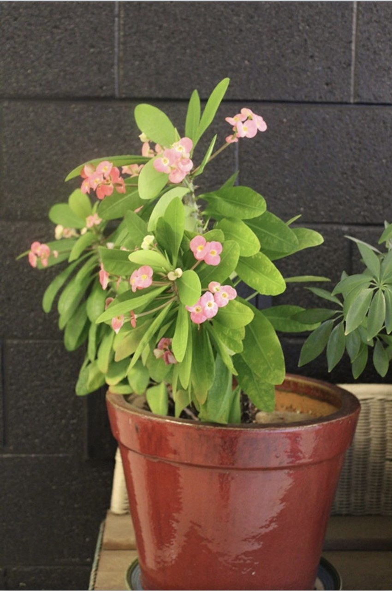
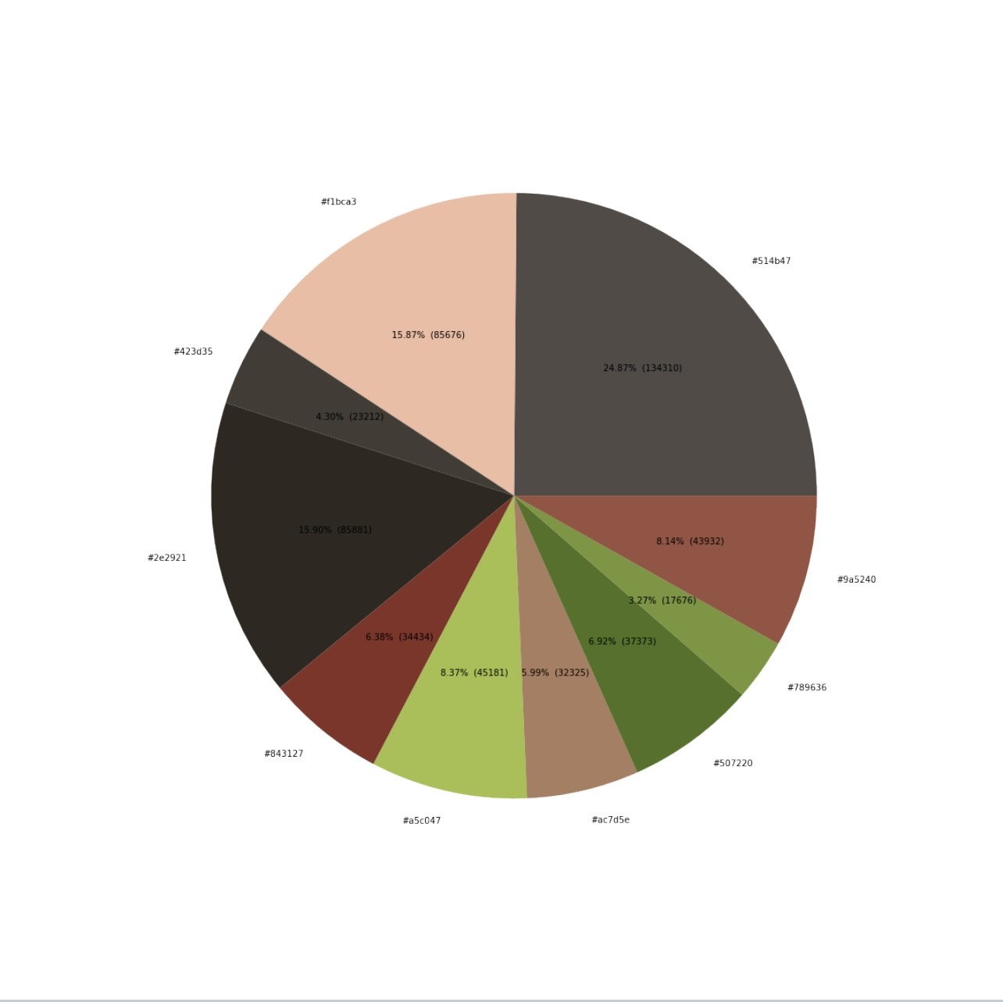
Complementary
1. Explain color harmony with color combination: Complementary scheme with green and pink.
2. Write 5 hex colors with percentages: #f1bca3 15.87%, #843127 6.38%, #a5c047 8.37%, #ac7d5e 5.99%, #507220 6.92%, #789636 3.27%, #9a5240 8.14%, #514b47 24.87%, #423d35 4.30%, #2e2921 15.90%.
3. What is the color of the main subject? #f1bca3 15.87%
4. What are complementary colors (color and percentage)? #f1bca3 15.87%, #a5c047 8.37%
5. What is the colors which are not complementary (color and percentage)? #514b47 24.87%, #423d35 4.30%, #2e2921 15.90%.

Slide 7
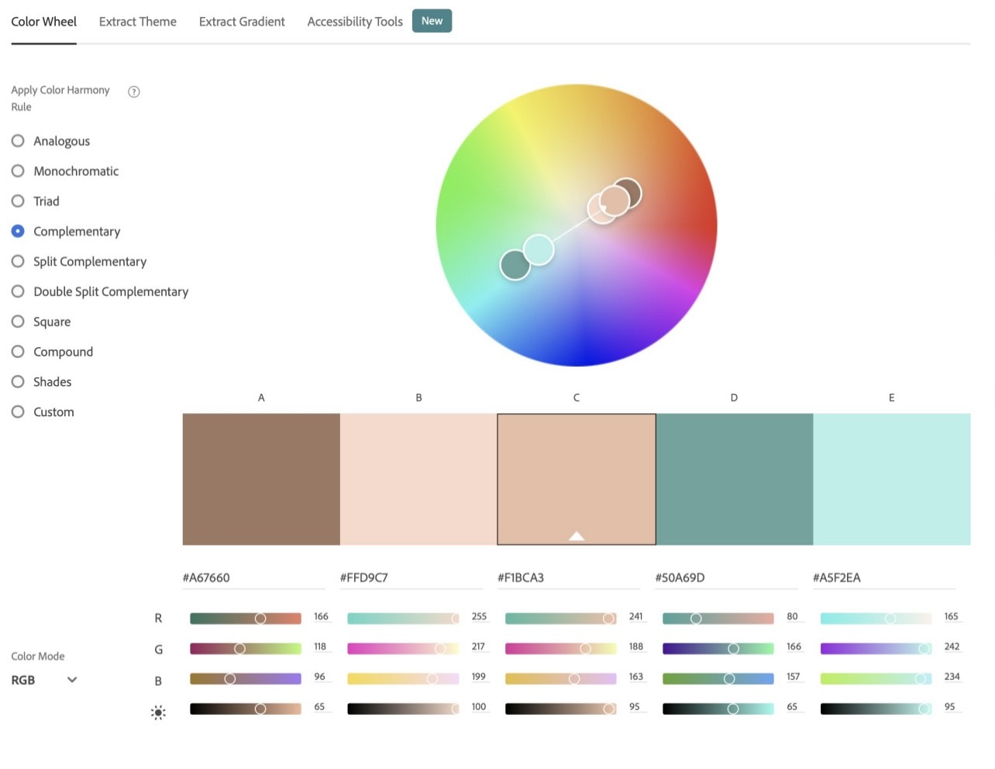
Improvement plan based on color analysis
6. Please write any suggestions to have better color harmony (2-3 sentences). This photo has a good complimentary color scheme. I really liked the complementary between the color of the flowers in the picture and the plants. Only thing wish I could change was getting closer to get the background wall picture and forgot.
7. Please provide us with your valuable comments/suggestions for data science, color theory, color analysis project, or cross-disciplinary project. I think this project was very interesting and fun because I got to learn a little bit about coding which was something I never did before.

